Slide 1
Introduction to Enterprise APPLiCATION Integration
Home of All the Laws of Nature
Notes:
last update: 4/3/2013

Slide 2
Why Do We Need Integration?
Enterprise business applications rarely live in isolation
Users expect instant access to all business functions an enterprise can offer
Requires disparate applications to be connected into a larger, integrated solution,
What Makes Integration so Hard?
Architecting integration solutions is a complex task
Many conflicting drivers and even more possible 'right' solutions
The success of integration not known, in some cases, for years
No set of underlying guidelines, principles and best practices.

Slide 3
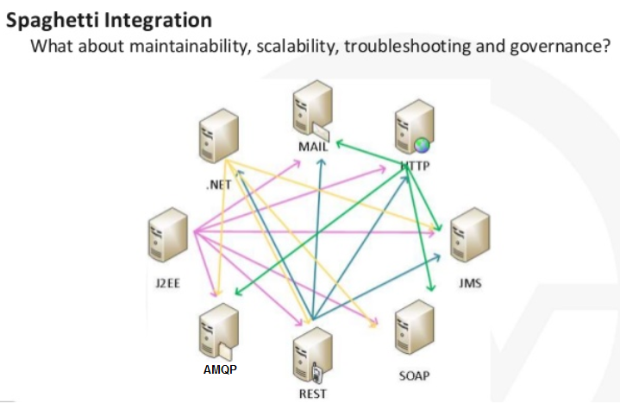
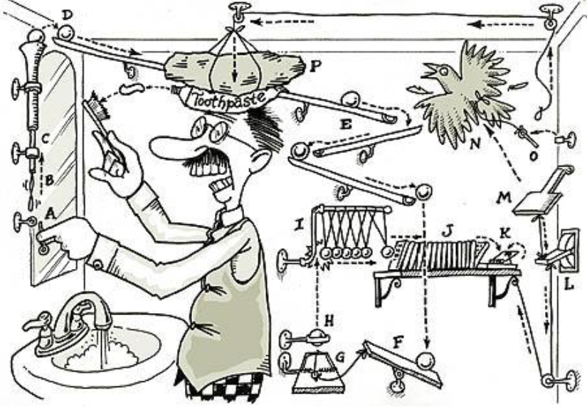
Enterprise Application Integration
Been around for as long as disparate computing paradigms have
EAI is integration of services and / or data.
Enterprise Application Integration platforms are known as:
Enterprise Service Bus (ESB)
“Traditional” ESB solutions - TIBCO, Axway, WebMethods
Open source / Java-centric solutions : ServiceMix, PEtALS, OpenESB, JBossESB, MuleSoft , Apache Camel
Non-ESB alternatives: solutions strung together with bailing wire and tape,
a veritable Rube Goldberg machine
Notes:
BizTalk, WebSphere MB, Mule, ServiceMix “FULL STACK”
A bit dated::
https://www.adroitte.com/blog/best-business-practices/spring-integration-mule-esb-or-apache-camel-which-is-the-most-reliable-integration-framework-for-performing-management-functions/
iPaas
https://www.mulesoft.com/resources/cloudhub/what-is-ipaas-gartner-provides-reference-model

Slide 4
Common ESB Capabilities
Location Transparency
Transport Conversion
Message Transformation / Routing / Enhancement
Security
Monitoring and management
Process management (BPMs, orchestration)
Complex Event Processing
Integration Approaches:
File Transfer
Shared Database
Remote Procedure Call
Messaging
Notes:
http://docs.spring.io/spring-integration/docs/2.0.0.M4/spring-integration-reference/html/security.html
// SPEED
https://www.slideshare.net/joshlong/dynamic-routing-at-1-million-messages-per-second-with-spring-integration

Slide 5
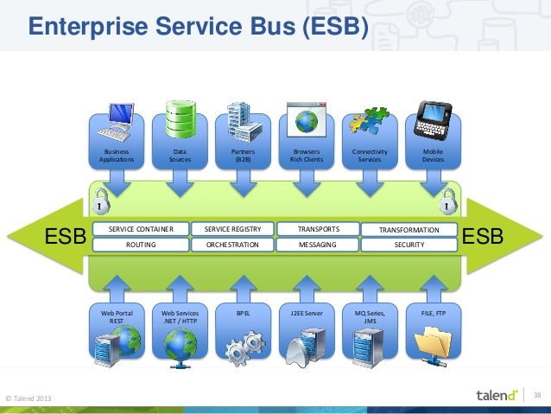
Enterprise Service Bus
Notes:
https://www.slideshare.net/KaiWaehner/enterprise-integration-patterns-revisited-eip-apache-camel-talend-esb
https://www.slideshare.net/KaiWaehner/enterprise-integration-patterns-revisited-again-for-the-era-of-big-data-internet-of-things-and-microservices

Slide 6
Spring Integration
NOT necessarily an ESB….
BUT
Does provide the framework and all the components
needed to do the same things that would make you consider an ESB in the first place.
A Spring Integration application is just a Spring application with some beans in the context that handle the integration concerns.
That means you can deploy anywhere and at any scale.
It is Lightweight

Slide 7
Spring Integration
Goals:
Provide a simple model for implementing complex enterprise integration solutions.
Facilitate asynchronous, message-driven behavior within a Spring-based application.
Promote intuitive, incremental adoption for existing Spring users.
Spring Integration is guided by the following principles:
Components should be loosely coupled for modularity and testability.
Enforce separation of concerns between business logic and integration logic
Extension points should be abstract & promote reuse and portability.
Implementation is an API based on Enterprise Integration Patterns.
Lightweight messaging using declarative adapters :
NOT another name for the Spring remoting APIs BUT
A High level of abstraction over Remoting, Messaging, and Scheduling
Enterprise Integration Patterns
"If you are involved with the operation or development of an enterprise application, there will doubtless come a time when you will need to integrate your application with another using the … preferred approach of messaging. When that time comes, this book will be your most valuable reference."--Randy Stafford, Oracle
Notes:
Spring Integration - not trying to be an ESB. However, we are trying to provide the framework and all the components you need to do the same things that would make you consider an ESB in the first place.
A Spring Integration application is really just a Spring application with some beans in the context that handle the integration concerns. That means you can deploy anywhere and at any scale.

Slide 8
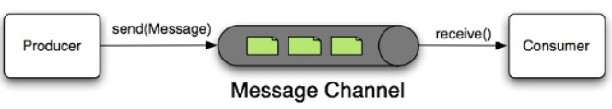
Spring Integration
Main Components
Message : It is a generic wrapper for any Java object combined with metadata used by the framework while handling that object. It consists of a payload and header(s).
Message Channel : A message channel is the component through which messages are moved so it can be thought as a pipe between message producer and consumer. [ PTP or Pub/Sub].
Message Endpoint : A message endpoint isolates application code from the infrastructure. In other words, it is an abstraction layer between the application code and the messaging framework. They are message producers & consumers.

Slide 9
[Some] Message Channels
Message channels in Spring Integration can be divided into two main categories:
Subscribe message channels
Pollable message channels
PublishSubscribe Channel
Mainly for events
Also can be used asynchronously
Queue Channel
FIFO Queue PTP
requires polling [poller]
Direct Channel [Default]
Single Consumer [PTP]
Notes:
PriorityChannel prioritized QueueChannel async
QUEUE multithreaded
Direct - no queue; Pub/sub model but round robin

Slide 10
Adapters and Gateways
Adapters are unidirectional
Gateways are Bidirectional
Example:
Amqp inbound-adapter
Amqp outbound-adapter
Amqp inbound-gateway
Amqp outbound-gateway
Notes:
how does the JMS outgoing-gateway know where to send the reply? By default it sends it back to the requester, using a temporary anonymous channel, so Spring Integration gives us that functionality for free. If you have special needs, to can specify the reply channel.
http://www.javaprocess.com/2015/05/spring-integration-services-part1.html
FOR BIDIRECTIONAL
The outgoing-gateway will create a temporary channel, and sets "ReplyTo" JMS header to this temporary channel.
https://freecontent.manning.com/wp-content/uploads/spring-does-that.pdf
<int-jms:outbound-gateway request-channel="toJMS"
reply-channel="jmsReplies"
request-destination-name="examples.gateway.queue"/>
The reply-channel is where any JMS reply messages are sent after they’re converted to Spring Integration messages.
we didn’t provide a reply-destination-name. That attribute is optional, but it’s common to leave it out. The gateway implementation provides the JMSReplyTo property on each request message it sends to JMS. If you don’t provide a specific destination for that, then it’ll handle creation of a temporary queue for that purpose.
https://dzone.com/articles/two-way-communication-jms
Good example JMS based temp queue WITHOUT Spring Integration
https://docs.spring.io/spring-integration/docs/2.0.0.M2/spring-integration-reference/html/ch19s06.html
JMS BACKED MESSAGE CHANNELS
<jms:channel id="jmsChannel" queue="exampleQueue"/>
Probably the most common rationale for using this alternative would be to take advantage of the persistence made available by the store and forward approach of JMS messaging.

Slide 11
Main Point
Spring Enterprise Integration provides for seamless operation of the enterprise by providing adaptive and structured resource coordination.
Without a doubt, the structure and adaptive nature of finer levels of consciousness...ultimately, Pure Consciousness makes one’s everyday experience seamless and smooth.

Slide 12
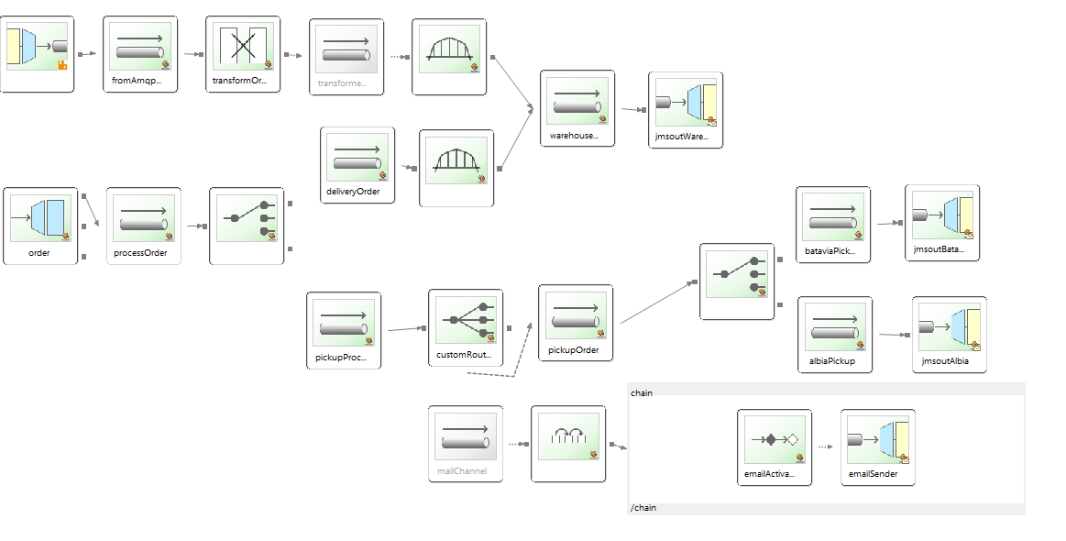
Specific Nomenclature for Demos
MANY,MANY ,MANY types of channels, adapters, endpoints
DEMO Diagram:
Some we will use in Demo:
Messaging Gateway : entry point for the system [encapsulates Message API ]
Message Router decides what channel(s) should receive the Message
Messaging Bridge endpoint that connects two Channels or Channel Adapters.
Channel Adapter is a Message Endpoint that enables connecting a single sender or receiver to a Message Channel
There are a LOT!
End point Support
Notes:
GATEWAY is an interface .. Implemented by Integration to process Message API
http://docs.spring.io/spring-integration/docs/2.0.0.M4/spring-integration-reference/html/security.html
http://docs.spring.io/spring-integration/reference/html/http.html INBOUND/OUTBOUND CHANNELS
Has REST support by introducing the IntegrationRequestMappingHandlerMapping. The implementation relies on the enhanced REST support provided by Spring Framework 3.1 or higher.

Slide 13
HQ to Warehouse Order Process
Use Case
Use Case:
Headquarters receives a Customer request via phone
Headquarters generates a Customer Order [Order]
It broadcasts the Order to the Warehouse through RabbitMQ
The Warehouse “listens” for orders on a JMS Queue.
The Warehouse accept & process an Order as a RouteOrder
Solution:
Listen for RabbitMQ Order message [Rabbit Adapter]
Transform Order Message to RouteOrder Message [Transformer]
Broadcast RouteOrder Message to Warehouse [JMS Adapter]
Notes:
RabbitMQ – JMS mismatch based on technologies implemented on respective servers

Slide 14



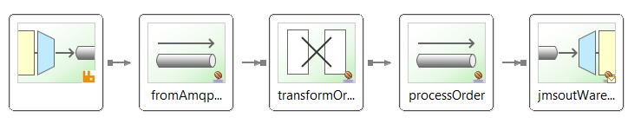
Spring EAI Components
A Channel is a message "pipe“. DirectChannel: simple point-to-point channel
An Adapter connects [thru a channel] to another system [Adapter]
Rabbit Inbound Adapter JMS Outbound Adapter
A Transformer converts a message payload from one format to another
Transformer

Slide 15
Configuration Details
<amqp:inbound-channel-adapter channel="fromAmqpOrder"
queue-names="purchasesPhone" connection-factory="amqpConnectionFactory" />
<channel id="fromAmqpOrder" />
<transformer id="transformOrder" ref="orderTransformer"
input-channel="fromAmqpOrder" output-channel="processOrder" />
<beans:bean id="orderTransformer"
class="edu.mum.integration.OrderTransformerImpl" />
<channel id="processOrder" />
<jms:outbound-channel-adapter id="jmsoutWarehouse"
channel="processOrder" destination="warehouseQueue"/>
See EAIBusAmqpJms Demo

Slide 16
Transformer Details
public class OrderTransformerImpl implements OrderTransformer {
/**
* Transform Order from AMQP to RouteOrder for JMS
*/
@Transformer(inputChannel="fromAmqpOrder", outputChannel="processOrder")
public RouteOrder transformOrder(Order order) {
String name = order.getItems().get(0).getProduct().getName();
int quantity = order.getItems().get(0).getQuantity();
int orderNumber = Integer.parseInt(order.getOrderNumber());
RouteOrder routeOrder = new RouteOrder(name, quantity, RouteOrderType.DELIVERY, orderNumber);
return routeOrder;
}

Slide 17
Customer Service RouteOrder to Warehouse
Use Case
Use Case:
Customer Service handles email orders via desktop [e.g. JavaFx]
Desktop App generates RouteOrder
The RouteOrder is broadcast to the Warehouse via JMS
The Warehouse “listens” for orders on a JMS Queue.
The Warehouse accept & process a RouteOrder
Solution:
Receive RouteOrder via Gateway
Broadcast RouteOrder Message to Warehouse

Slide 18

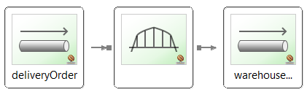
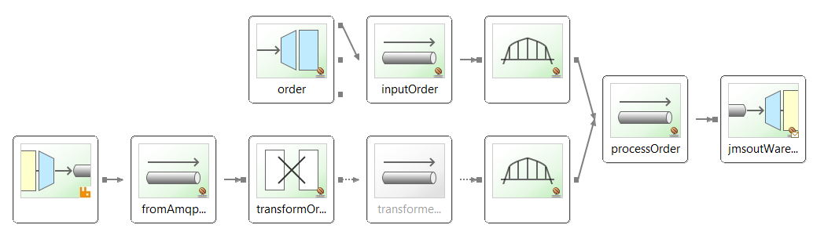
[More] Spring EAI Components
A Gateway converts input from local Application to EAI Messaging API
A Bridge connects two channels
Bridge
Updated EAI Diagram

Slide 19
Configuration Details
<gateway id="order" service-interface="edu.mum.integration.OrderGateway"
default-request-channel="inputOrder"/>
<channel id="inputOrder" />
<bridge input-channel='inputOrder' output-channel='processOrder'/>
<channel id="fromAmqpOrder" />
<amqp:inbound-channel-adapter channel="fromAmqpOrder"
queue-names="purchasesPhone" connection-factory="amqpConnectionFactory" />
<transformer id="transformOrder" ref="orderTransformer"
input-channel="fromAmqpOrder" output-channel="transformedOrder" />
<beans:bean id="orderTransformer" class="edu.mum.integration.OrderTransformerImpl" />
<!-- input order && transformedOrder channels need to go to JMS -->
<bridge input-channel='transformedOrder' output-channel='processOrder'/>
<channel id="processOrder" />
<jms:outbound-channel-adapter id="jmsoutWarehouse" channel="processOrder"
destination="warehouseQueue"/> See EAIBusDesktop Demo
See EAIBusAmqpJms Demo
… from EAIBusAmqpJms Demo

Slide 20
Order Gateway
// The entry point for the Bus Flow.
public interface OrderGateway {
//Process a book order.
@Gateway(requestChannel="processOrder")
public void process(RouteOrder order);
}

Slide 21
Customer Service Order for Store Pickup
Use Case
Use Case:
Customer chooses option to pickup order at store
The RouteOrder is broadcast to the store via JMS
The Store “listens” for orders on a JMS Queue.
The Store accepts & processes a RouteOrder
A notification email is sent to the Customer
Solution:
Determine to send RouteOrder to store [via Content Router[
Branch to dual activities[JMS&Email [via recipient-list-router]
Send Email to Customer [via Mail Adapter]
Broadcast RouteOrder Message to Store [via JMS Adapter]

Slide 22



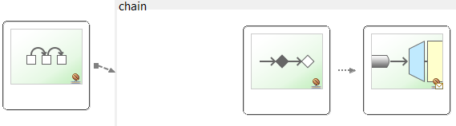
[More] Spring EAI Components
A Content Router examines the payload to determine message channel
A recipient-list-router distributes the message to all message channels
A chain is a convenience to reduce channels between endpoints
A Service Activator triggers (or activates) a Spring-managed bean
Chain Service Mail Adapter
Activator
OR
AND

Slide 23
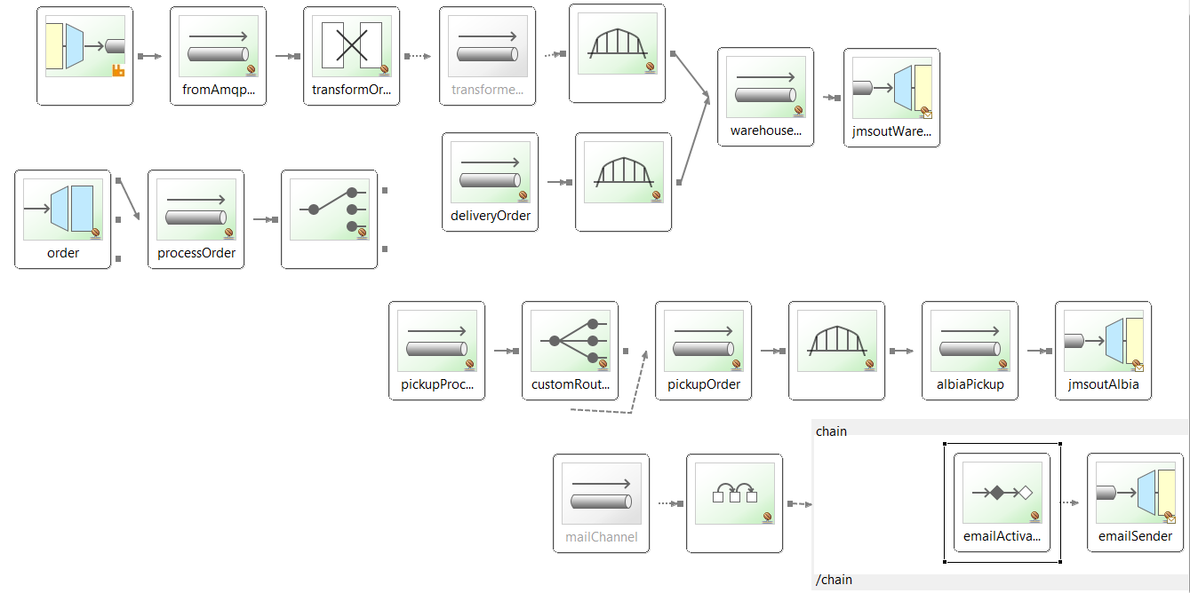
Store DEMO Integration graph
cccc

Slide 24

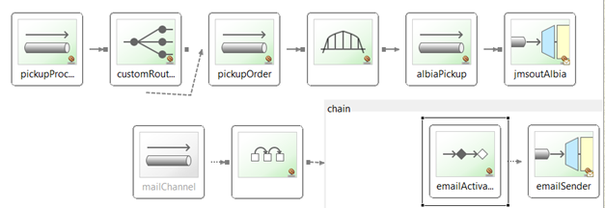
Configuration Details
<!-- "ref" refers to custom Router:ordeRouter "method" is the message channel -->
<router input-channel="processOrder" ref="orderRouter" method="processOrder"/>
<channel id="pickupProcess" />
<recipient-list-router id="customerRouter" input-channel="pickupProcess" >
<recipient channel="pickupOrder"/>
<recipient channel="mailChannel"/>
</recipient-list-router>
<!-- Service Activator triggers emailService Bean to send email-->
<chain input-channel="mailChannel">
<service-activator id="emailActivator" ref="emailService"/>
<mail:outbound-channel-adapter id="emailSender" mail-sender="mailSender" />
</chain> See EAIBusStore Demo

Slide 25
Order Router
@MessageEndpoint
public class OrderRouter {
// Process order. Routes based on whether or
* not the order is a delivery or pickup.
@Router(inputChannel="processOrder")
public String processOrder(RouteOrder order) {
String destination = null;
switch (order.getRouteOrderType()) {
case DELIVERY:
destination = "deliveryOrder";
break;
case PICKUP:
destination = "pickupProcess";
break;
}
return destination;
}

Slide 26
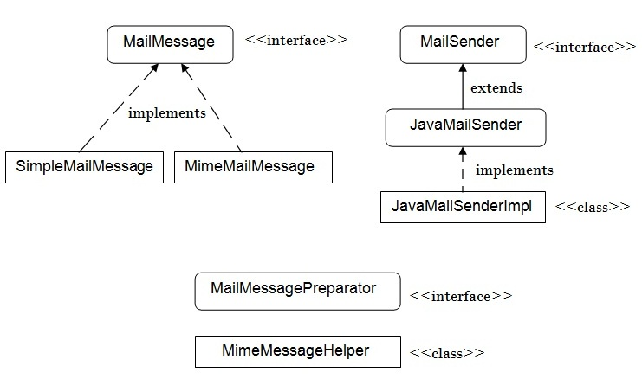
Spring Email Support
Messaging of a different sort
Utility library for sending email
Shields the developer from the specifics of the underlying mailing system
Responsible for low level resource handling on behalf of the client.
We will implement with…
See EMAIL Demo
Notes:
<property name="username" value="i.am.that.guy545@gmail.com" />
<property name="password" value="Iamthatguy545" />

Slide 27
Template Engine
Spring Email capability - simple text emails
Enterprise application need more “substance”
Writing HTML-based email content in Java code is tedious and error prone
There is no clear separation between display logic and business logic
Changing the display structure of the email requires writing Java code,
recompiling, redeploying etc…
Template Engines:
  FreeMarker : Velocity : Thymeleaf : Handlebars : Mustache
View Templates (For rendering views in your browser)
Email Templates - with support for both HTML and Text emails

Slide 28
Thymeleaf
Java XML / XHTML / HTML5 template engine
Complete substitute for JSP with Natural Templating abilities
Provides full Spring MVC web integration
Can be used offline
HTML email is an example offline application
Create feature-rich HTML email templates with expressions,
internationalization, date/number formatting, etc.
Email templates can be designed by UI designers as usual HTML pages Displayable on a browser as working templates.
Thymeleaf.org
Notes:
Multipurpose Internet Mail Extensions (MIME)
way of identifying files on the Internet according to their nature and format.

Slide 29
Online Order to Warehouse
Use Case
Use Case:
Customer makes a purchase on E-commerce web site
Web Site generates an Order and sends it via HTTP
A RouteOrder is broadcast to the Warehouse via JMS
The Warehouse “listens” for orders on a JMS Queue.
The Warehouse accept & process a RouteOrder
Solution:
Receive HTTP Order via HTTP Adapter
Merge Order with HQ Order to transform to RouteOrder

Slide 30
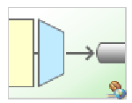
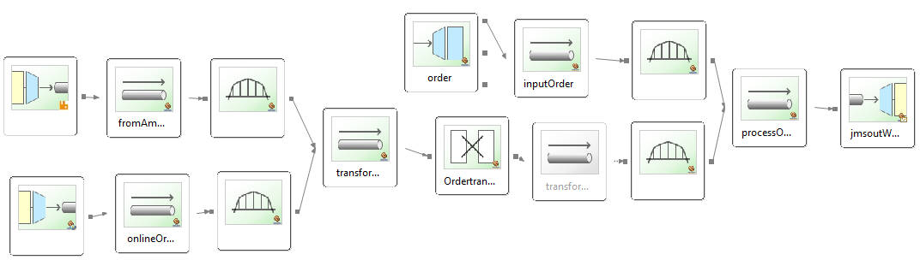
[More] Spring EAI Components
A HTTP Inbound Channel Adapter
A Bridge is for connecting channels
Bridge
Updated EAI Diagram
Subsection

Slide 31
Configuration Details
<channel id="fromAmqpOrder" />
<amqp:inbound-channel-adapter channel="fromAmqpOrder"
queue-names="purchasesPhone" connection-factory="amqpConnectionFactory" />
<bridge input-channel='fromAmqpOrder' output-channel='transformOrder' />
<channel id="onlineOrder"/>
<http:inbound-channel-adapter channel="onlineOrder"
status-code-expression="T(org.springframework.http.HttpStatus).NO_CONTENT"
supported-methods="POST" path="/onlineOrder"
request-payload-type="edu.mum.domain.Order">
<http:request-mapping consumes="application/json" />
</http:inbound-channel-adapter>
<bridge input-channel='onlineOrder' output-channel='transformOrder' />
<transformer id="transformOrder" ref="orderTransformer" See EAIBusHttpOnline Demo
input-channel=" transformOrder " output-channel="transformedOrder" />
<beans:bean id="orderTransformer" class="edu.mum.integration.OrderTransformerImpl" />

Slide 32
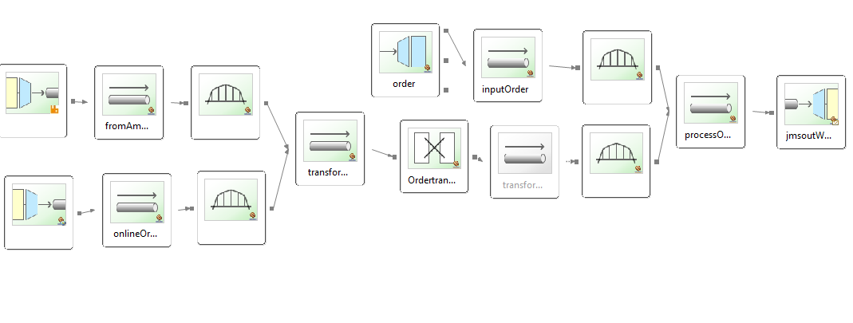
Online order
“Subsection”

Slide 33
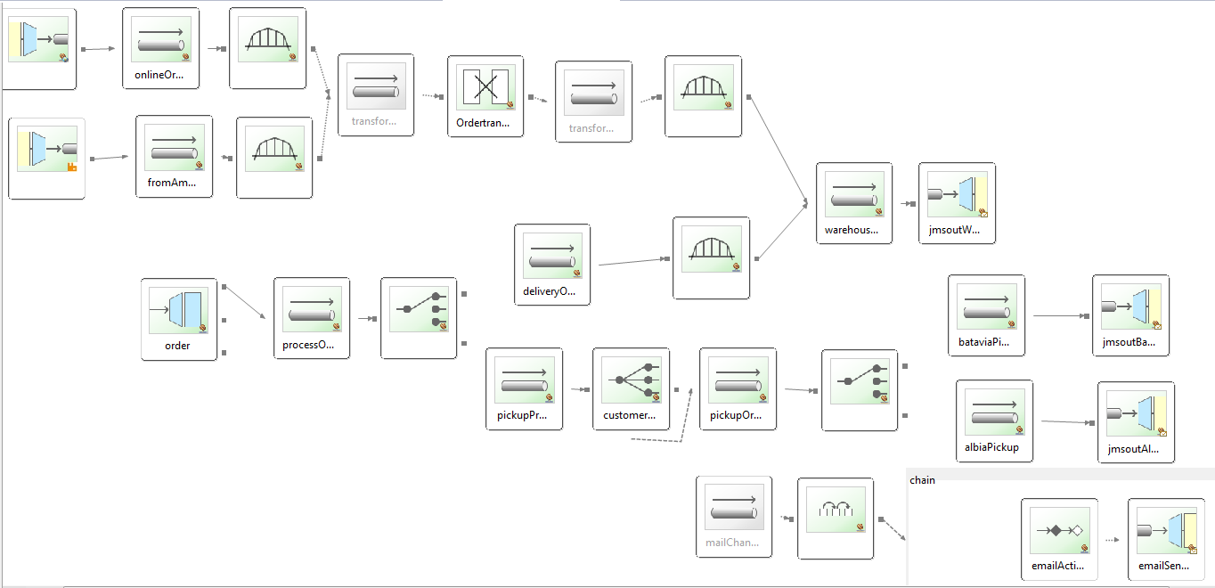
Final Spring EAI Demo

Slide 34
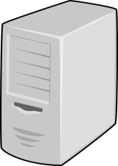

“Bus” view of Spring Integration Demo
Headquarters Desktop Warehouse
E-Commerce Stores [Batavia, Albia…]

Slide 35
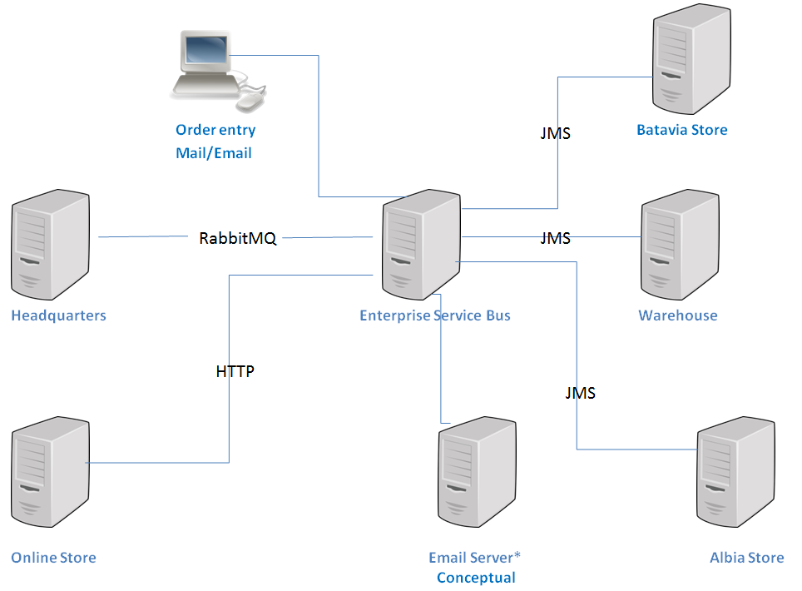
ESB Order Demo
Network Diagram

Slide 36
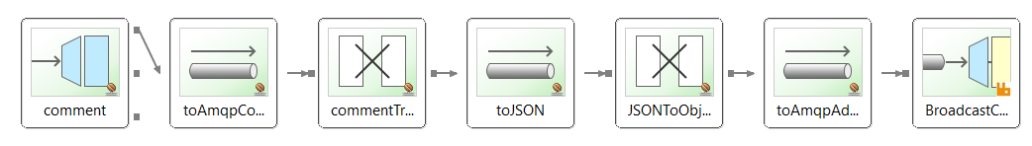
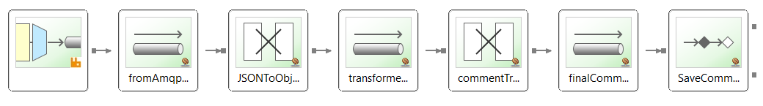
Lightweight Integration Technology
A Spring Integration application is just a Spring application with some beans in the context that handle the integration concerns.
That means you can deploy anywhere and at any scale.
It is Lightweight
Lesson 13 DEMO:
MemberRestBound: Broadcasts New Comment
MongoJerryBound: Subscribes to Comment Broadcast

Slide 37
Main Point
Enterprise Application Integration provides an “almost” endless variety of components.
Life is characterized by an infinite range of possibilities

